Slide 1

HUMAN VS AI DISTINGUISHMENT
Final Team Project Group 2
AAI-590: Capstone Project
University of San Diego
Applied Artificial Intelligence Program
Jeremy Cryer, Jason Raimondi, and Shane Schipper
April 15, 2024
Notes:
Jason:
Introduce project and team members

Slide 2
PRESENTATION OVERVIEW
Problem Statement
Live Web App Demo
Datasets and Prep
Methodology Approaches
Training and Evaluation
Selection and Results
Production Readiness
Notes:
Jason:
Overview of presentation areas

Slide 3
PROBLEM STATEMENT
Problem Statement: Advancements in Artificial Intelligence (AI) is making it increasingly difficult to distinguish text as being human or AI-generated
Areas of Concern:
News Feeds
Academic Integrity
Primary Goal: Develop a Machine Learning (ML) model that can predict and provide the probability of text being human or AI-generated
Secondary Goal: Develop an interactive web app for users to interact with the model
Concepts:
Traditional ML Algorithms
Transformer-based Models
Containerization
Notes:
Jason:
Overview of Problem Statement, Areas of Concern, Primary/Secondary Goals, and Concepts

Slide 4
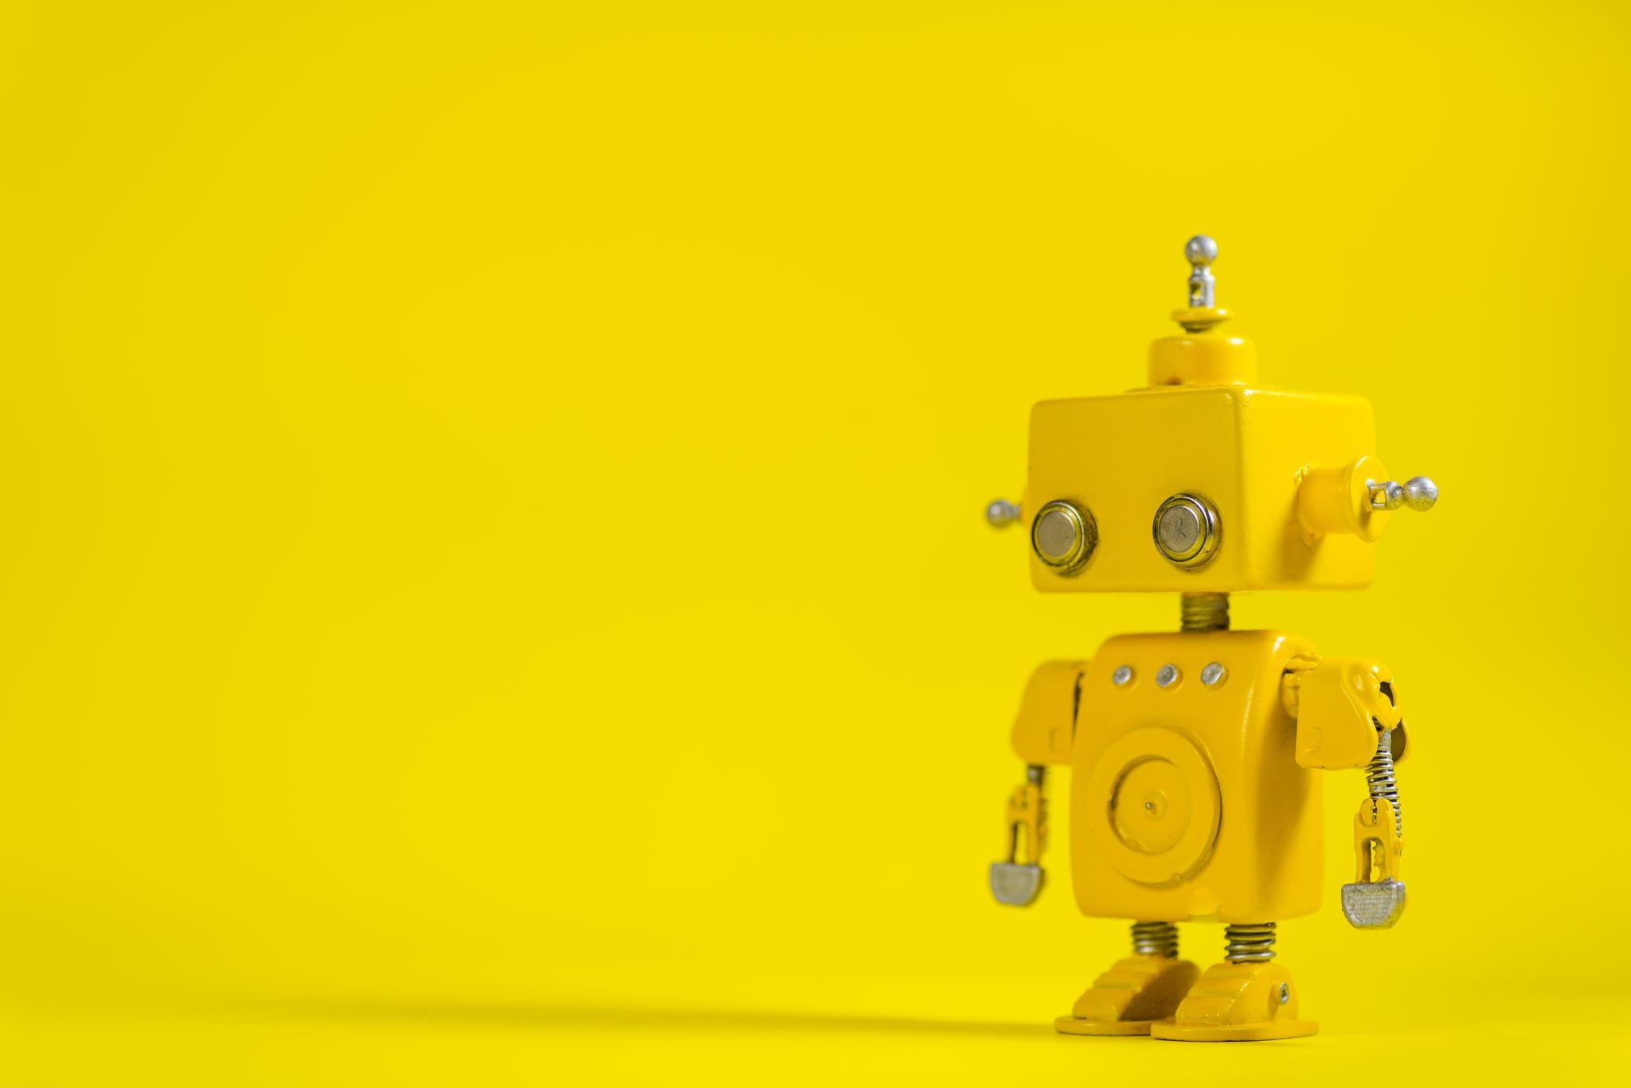


LIVE WEB APP DEMO
Launch
Web App
Demo
Notes:
Jason:
Launch and present live web app demo

Slide 5
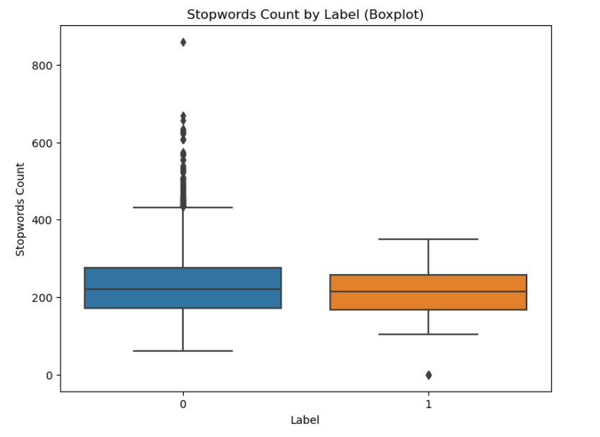
DATASETS AND PREP
Datasets
Training
AI vs Human Text
Nearly 500,000 Samples
Inference
AI vs Student Text
1,103 Samples
Prep
Minimal Preprocessing
Remove samples missing data
Downsample majority class
Tokenization, including:
Words/Subwords
Stop Words
Capitalization
Punctuation
Notes:
Jeremy:
Introduce both datasets
Discuss preprocessing
Discuss Tokenization

Slide 6
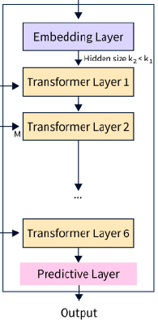
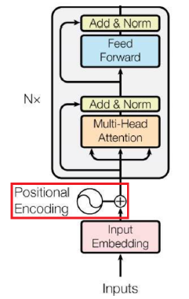
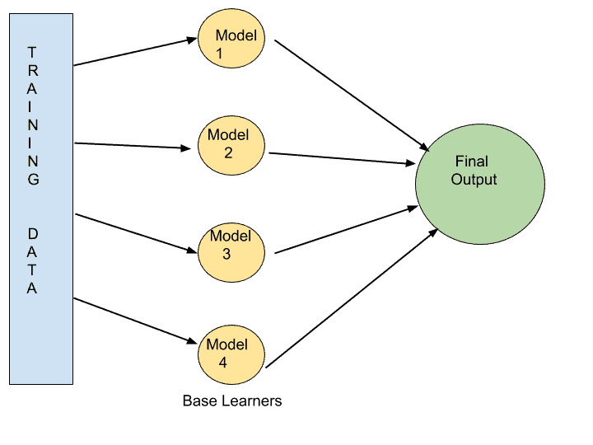
METHODOLOGY APPROACHES
Pretrained Transformer
Custom Transformer
Traditional Algorithm
DistilBERT
Proven Solution
Low Development
PyTorch Framework
Flexible Configuration
High Development
Random Forest
Lower Complexity
Moderate Development
Adapted from Distinguishing Human Generated Text From ChatGPT Generated Text Using Machine Learning by Islam et al. (2023). [DistilBERT architecture] [Image]. arXiv. https://doi.org/10.48550/arXiv.2306.01761
Adapted from Language modeling with nn.transformer and torchtext (n.d.). [Transformer architecture] [Image]. PyTorch.
https://pytorch.org/tutorials/beginner/transformer_tutorial.html
From Random Forest algorithm, a complete and Super Easy Guide, by Aqsazafar (n.d.). [Ensemble with Base Learners] [Image]. MLTut. https://www.mltut.com/random-forest-algorithm-a-complete-and-super-easy-guide/
Notes:
Jeremy:
Run through each category/comparison for each approach
Pretrained Transformer - For “Proven Solution,” this is one approach we researched for a similar task

Slide 7
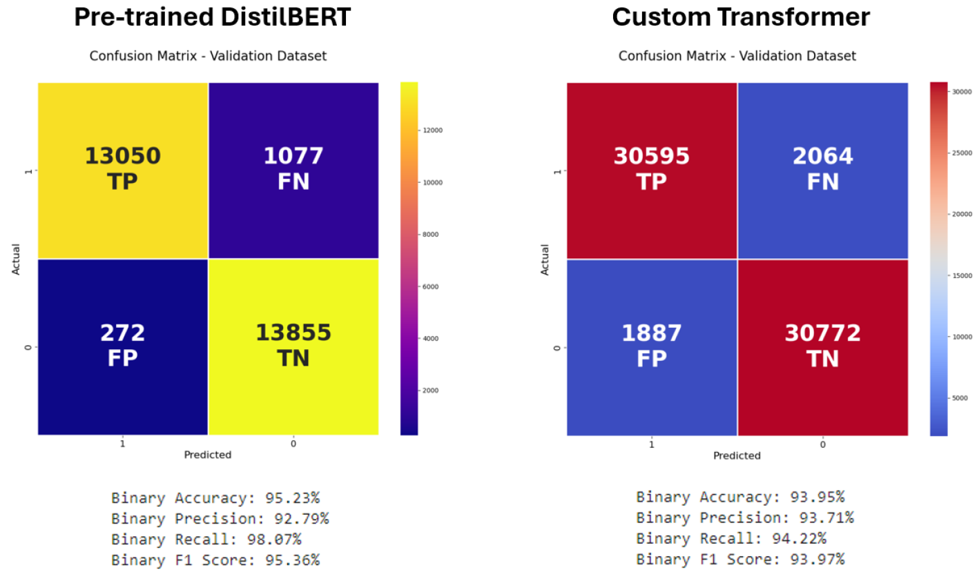
TRAINING AND EVALUATION
Notes:
Shane:
Traditional models did not generalize well and massively over-predicted the positive class for “production” data outside of the dataset
Thus, it was decided to focus solely on comparing the pre-trained DistilBERT model with the custom transformer model
A few points of interest in the confusion matrices displayed:
The large difference between overall numbers is due to only the custom model being trained on the entire dataset (computational challenges for pretrained)
Pretrained DistilBERT model shows better accuracy, recall, and F1 score, whereas the custom transformer model has better precision
Despite some higher metrics displayed for the pretrained model, our team still selected the custom model as the best model for 2 reasons:
1st) Predictions were more consistent - both the correct and incorrect predictions were very well-balanced for each individual class, whereas the pretrained model’s incorrect predictions were heavily skewed to about 20% false positives and 80% false negatives
2nd) The pretrained model was trained on a much smaller dataset, so the team felt more confident with the custom model being trained on the entirety of the dataset for better generalization in production

Slide 8
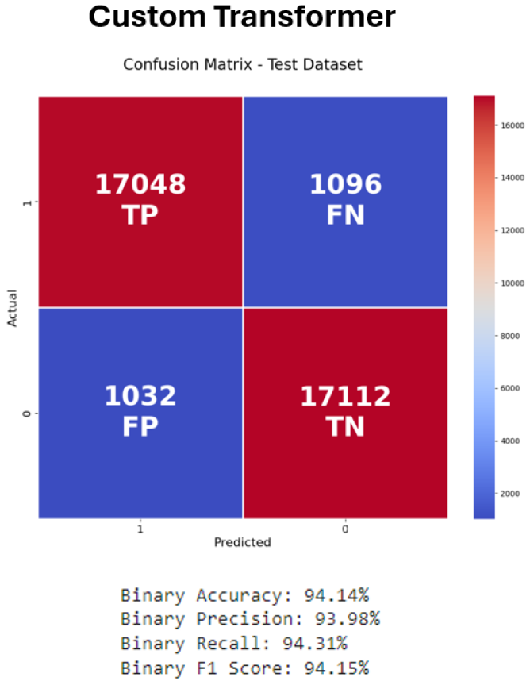
SELECTION AND RESULTS
Notes:
Shane:
As mentioned, we selected the custom transformer implementation as our team’s best model
This confusion matrix is the same custom model but evaluated on our split of the data reserved specifically for testing purposes
We can see that the model performs comparably well on the test dataset as it did previously with the validation dataset, as shown by its high accuracy, additional metrics, as well as also having very well-balanced correct and incorrect predictions. This is a great indication that the model is generalizing well, demonstrating the best robustness to external data.

Slide 9

PRODUCTION READINESS
Model Robustness
Increase training data size to > 1M samples
Increase text diversity
Variable length
Writing styles
Ensure AI source diversity
ChatGPT
Bard
Others
Compute Resources
Utilize High-Performance Computing (HPC) resources
Increase model training duration
High memory runtimes
Additional GPUs
Increase web app scalability
Notes:
Shane:
For a production model we would like to target a dataset that is at least 1M samples large and has good source diversity
This could be done at minimal cost using APIs like CHATGPT and web scraping
These data improvements should help to increase the models robustness to variations in writing style and text length
For training we would like to increase the amount of epochs we are able to train the model for which requires more dedicated compute power
Additionally, in order to scale the app, we would likely need dedicated GPU nodes to minimize inference time when many users are active

Slide 10

THANK YOU!
Please contact us with any questions.
Jeremy Cryer
jcryer@sandiego.edu
Jason Raimondi
jraimondi@sandiego.edu
Shane Schipper
shaneschipper@sandiego.edu
This Photo by Unknown Author is licensed under CC BY-SA-NC
Notes:
Shane:
Conclude the presentation

